Slide 1
The cost structure and cost efficiency of road maintenance in Dutch municipalities: a stochastic frontier analysis
Thomas Niaounakis, Alex van Heezik, Jos Blank
September 7th, 2018
6th International Workshop on “Efficiency in Eduction, Health and other Public Services”, Huddersfield Business School

Slide 2
  Road maintenance
380 municipalities maintain over 90% of Dutch road network
  Length ±119.000 km
Yearly cost ±€4 billion
Report originally commissioned for Dutch ministry of the Interior → policy-oriented paper
  SFA
  Focus on illustrating relation heterogeneity and productivity (environmental factors)
  Estimation of cost efficiency: benchmarking tool

Slide 3
  Motivation
Despite being at the core of many local government activities, road maintenance cost and efficiency studies are relatively scarce
Equalizing grant: Dutch municipalities should be able to provide citizens equal service levels given their operating environment →
  cost structure
  Road maintenance cost is widely viewed to depend strongly on e.g. soil quality or urbanization
Large degree of autonomy: efficiency differences viable

Slide 4
  Related literature
Wheat, P. (2017). Scale, quality and efficiency in road maintenance: Evidence for English local authorities. Transport Policy, 59, 46–53. http://doi.org/10.1016/j.tranpol.2017.06.002
O’Donnell, C. J., Fallah-Fini, S., & Triantis, K. (2017). Measuring and analysing productivity change in a metafrontier framework. Journal of Productivity Analysis, 47(2), 117–128. http://doi.org/10.1007/s11123-017-0494-6
Kalb, A. (2014). What Determines Local Governments’ Cost-efficiency? The Case of Road Maintenance. Regional Studies, 48(9), 1483–1498. http://doi.org/10.1080/00343404.2012.731044
Fritzsche, C. (2018). Analyzing the Efficiency of County Road Production - Evidence from Eastern German Counties. German Economic Review, 1–21. http://doi.org/10.1111/geer.12170
Deller, S. C., & Halstead, J. M. (1994). Efficiency in the Production of Rural Road Services: The Case of New England Towns. Land Economics, 70(2), 247–259. http://doi.org/10.2307/3146326
Deller, S. C., Chicoine, D. L., & Walzer, N. (1988). Economies of Size and Scope in Rural Low-Volume Roads. The Review of Economics and Statistics, 70(3), 459–465. http://doi.org/10.2307/1926784

Slide 5
  Focus of this paper
1. Cost structure
Heterogeneity and productivity
Economies of scale
2. Cost efficiency
SFA
Policy aim: illustrating the potential use of SFA as tool for benchmarking municipalities
3. Efficiency determinants
grant size, fly-paper effect, local taxpayer monitoring
Qualitatively: maintenance strategies, outsourcing, tendering

Slide 6
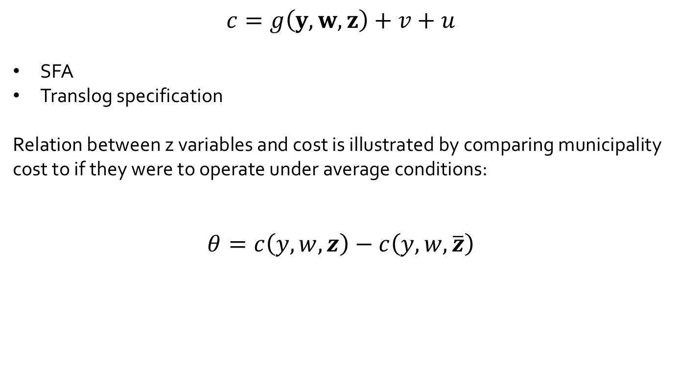
  Methodology
$$c=g\left(y,w,z\right)+v+u$$
SFA
Translog specification
Relation between z variables and cost is illustrated by comparing municipality cost to if they were to operate under average conditions:
$$θ=c\left(y,w,z\right)−c\left(y,w,\overline{z}\right)$$

Slide 7
  Included variables
Cost: Municipality cost between 2008-2014 (±390 municipalities)
Output: road length (in km)
Environmental:
  soil quality: softer soil requires more maintenance
  bank length: larger bank length requires more bridges
  urbanization (complexity)
  Road use (intensity)
Input prices: sector-specific price index

Slide 8
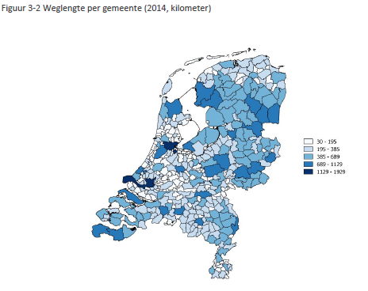
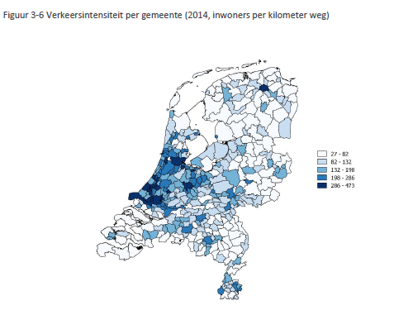
  Road length and use
Road length
Inhabitants per km road

Slide 10
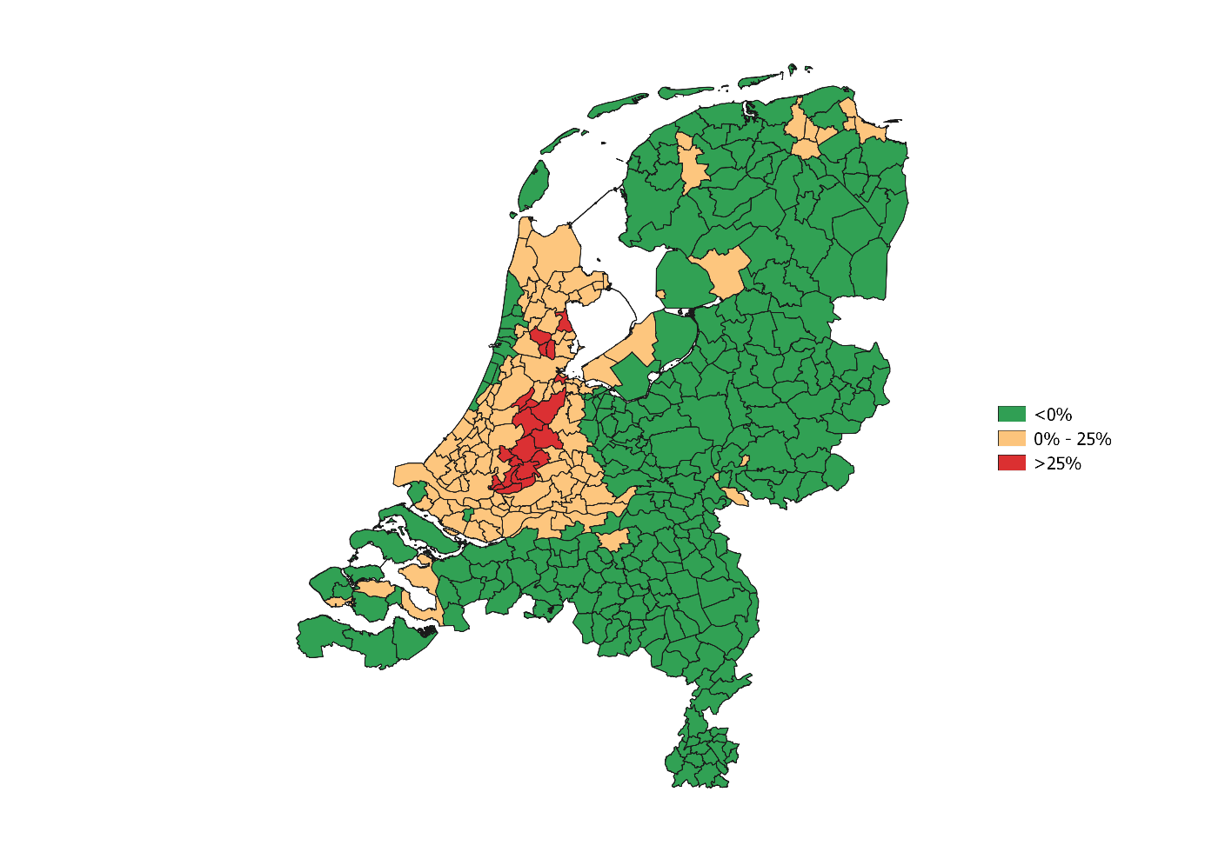
  Results: cost differences due to soil quality and bank length

Slide 12
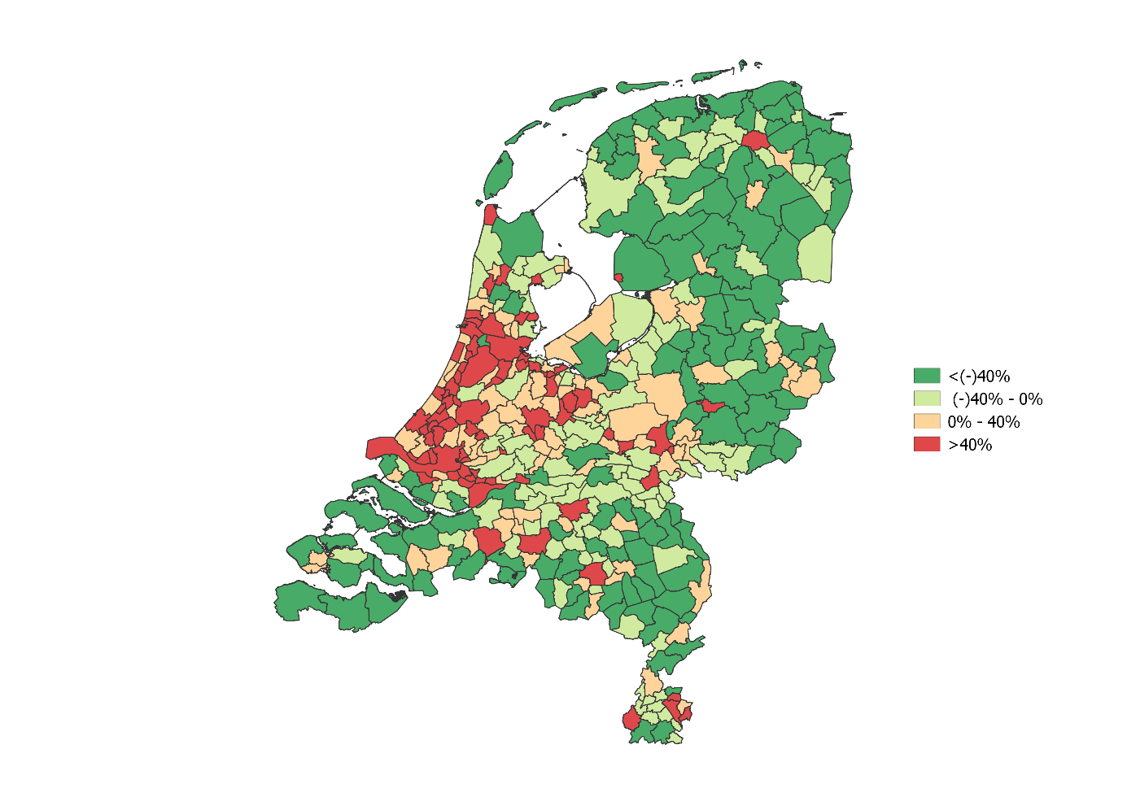
  Results: cost differences due to road use and urbanization

Slide 14
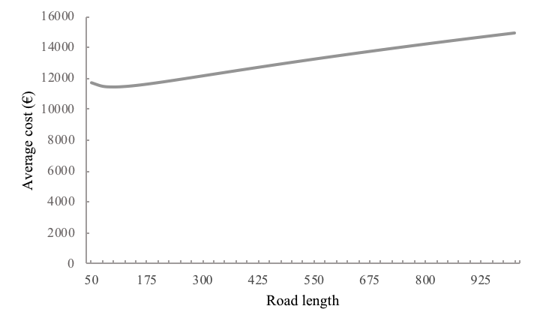
  Economies of scale

Slide 15
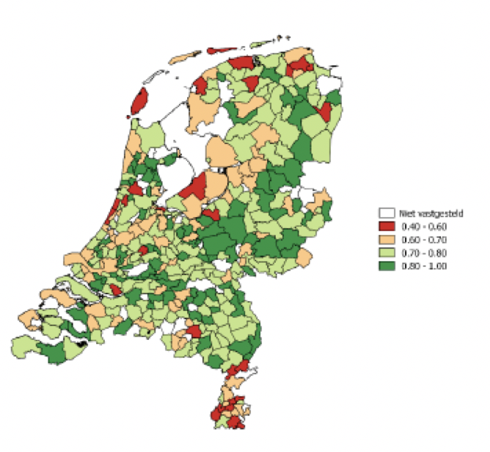
  Cost efficiency
Average cost efficiency = 0.78

Slide 16
  Efficiency determinants: preliminary
Larger grants may lead to higher local government inefficiency (e.g. de Borger & Kerstens (1996), Kalb (2014))
  related flypaper hypothesis: money sticks where it hits (increasing grants leads to increased spending instead of lowering local tax)
Local taxpayer effect: larger dependence on local taxes leads to increased monitoring and thus efficiency
No significant relations found

Slide 17
  Q&A
Thank you for your attention!

