Slide 1

Policy reforms and productivity change in the judiciary system: A cost function approach applied to time series data of the Dutch judiciary system 1980-2016
September 7, 2018
6th International Workshop on
“Efficiency in Education, Health and other Public Services”, Huddersfield
Prof. Jos LT Blank (TU Delft, Erasmus U. Rotterdam)
Dr. Alex AS van Heezik
www.ipsestudies.nl

Slide 2
  Outline
Background of the study
Policy reforms in the Netherlands
Methodology
  Model specification
  Estimation
Data: TiPS (Trends in Public Sector)
  Production trends
  Input trends
Results
  Productivity growth
  Decomposition
Conclusions
Notes:
We hebben een maand geleden ook een onderzoek afgerond. Dat onderzoek gaat over schoolgebouwen.
Of om preciezer te zijn: over de kosten van schoolgebouwen.
Even kort wat over het stelsel. Dat werkt als volgt. Schoolgebouwen zijn een gezamenlijke verantwoordelijkheid van gemeenten en schoolbesturen.
Dat is zo sinds 1997: toen zijn verantwoordelijkheden gedecentraliseerd van het Rijk naar gemeenten, en een aantal verantwoordelijkheden die gemeenten al hadden naar schoolbesturen.
Gemeenten doen de nieuwbouw, uitbreiding, grootschalige renovaties, echt de langdurige investeringsposten.
Zodra we het schoolgebouw ingaan, is het schoolbestuur aan zet. Zij betalen de energierekening en verzorgen het onderhoud.
Even om een indruk van de orde van grotote

Slide 3
  Background and research question
Safety and justice under increasing pressure
Crime rates
Civil and adminstrative complexity
How to contain costs:
Consolidation
Performance funding
Benchmarking
Autonomy, Council of the Judiciary
Note: monopoly, trias politica
What is the productivity growth between 1980 and 2016 in the judiciary system?
Is there a relationship between major policy reforms and productivity growth in the system?

Slide 4
  Timeline of policy reforms
Increasing discretionary power PPS (1983)
Integration of military law (1991)
Act on the organization and management of courts (2001)
Output
budgetting
(2005)
Abolition of cost-free litigation (1984)
General Administrative Law Act (1992/1994)
Reorganization Prosection office (1999)
new budgetting system
(2002)
Prosecution office Settlement Act (2006)
Act on the reform of the Judicial Map (2013)
Law Administrative Enforcement of Traffic Regulations (1989/1992)
Act on the Council for the Judiciary (2002)
Reform tax judiciary
(2005)
1980
1985
1990
1995
2000
2005
2010
2015

Slide 5
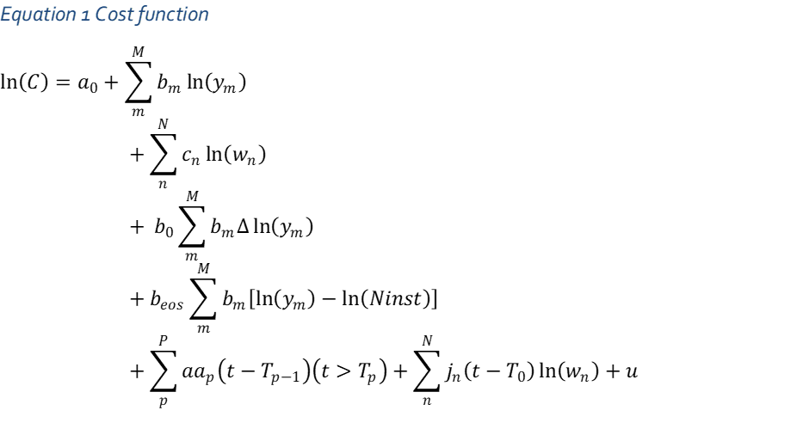
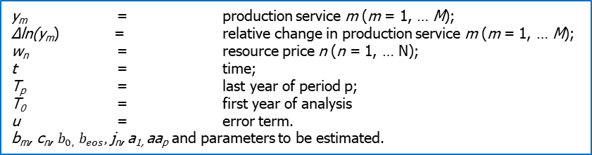

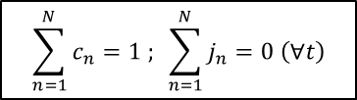
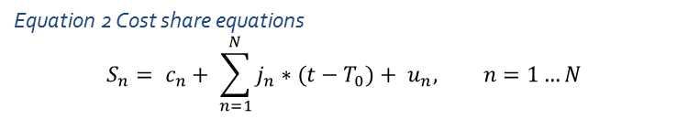
  Methodology
y_{m} = production service m (m = 1, … M);
∆ln(y_{m}) = relative change in production service m (m = 1, … M);
w_{n} = resource price n (n = 1, … N);
t = time;
T_{p} = last year of period p;
T₀ = first year of analysis
u = error term.
b_{m}, c_{n}, $b_{0,}$ $b_{eos},$j_{n}, a_{1,} aa_{p} and parameters to be estimated.
$$\sum_{m=1}^{M}{b_{m}}=1$$
$$\sum_{n=1}^{N}{c_{n}}=1 ; \sum_{n=1}^{N}{j_{n}}=0 \left(∀t\right)$$
Verdoorn’s law
Economies of scale
Equation 2 Cost share equations
$$S_{n}= c_{n}+ \sum_{n=1}^{N}{j_{n}∗(t−T_{0})}+ u_{n}, n=1…N$$
S_{n} = cost share of resource n

Slide 6
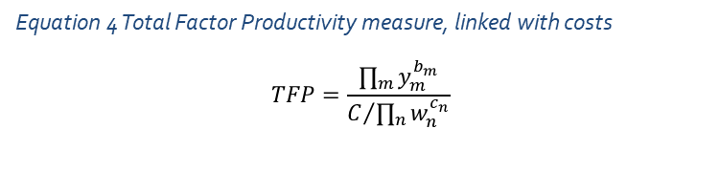
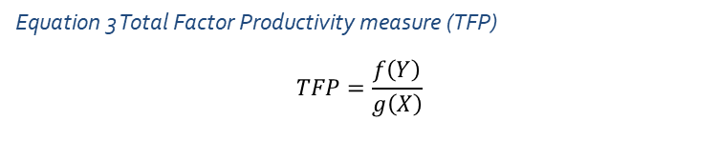
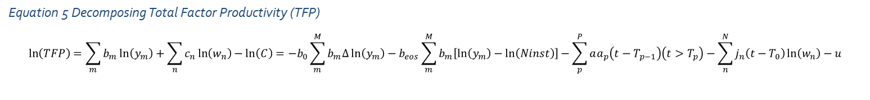
  Methodology: productivity decomposition
Equation 3 Total Factor Productivity measure (TFP)
$$TFP=\frac{f\left(Y\right)}{g\left(X\right)}$$
Equation 4 Total Factor Productivity measure, linked with costs
$$TFP=\frac{\prod_{m}{y_{m}^{b_{m}}}}{C/{\prod_{n}{w_{n}^{c_{n}}}}}$$
Equation 5 Decomposing Total Factor Productivity (TFP)
$$\ln\left(TFP\right)=\sum_{m}{b_{m}\ln\left(y_{m}\right)}+\sum_{n}{c_{n}\ln\left(w_{n}\right)−\ln\left(C\right)={−b}_{0}\sum_{m}^{M}{b_{m}∆\ln\left(y_{m}\right)−b_{eos}\sum_{m}^{M}{b_{m}\left[\ln\left(y_{m}\right)−\ln\left(Ninst\right)\right]−\sum_{p}^{P}{aa_{p}\left(t−T_{p−1}\right)\left(t>T_{p}\right)−\sum_{n}^{N}{j_{n}\left(t−T_{0}\right)\ln\left(w_{n}\right)−u}}}}}$$

Slide 7
  Methodology: estimation
System estimation
Non-linear estimation (Shazam: NL procedure)
2nd order autoregressive

Slide 8
  Database: Trends in Public Sector
Coherent database on public sector services:
Fifteen major public services
Annual figures 1979-present
Hundreds of (consistent) time series, including:
  Outputs
  Inputs
  Input prices
  Quality measures
  Environmental variables
Policy reforms
Hell of a job!
https://www.trendsinpubliekesector.nl/login/maintenance/token/jh3i8ujsakjdsa

Slide 9
  Data: production

Slide 10
  Data: inputs

Slide 11
  Results
CRS not rejected
Instant input adjustment rejected
Unbiased technical change rejected
Capital extensive??

Slide 12
  Results: productivity growth

Slide 13
Increasing discretionary power PPS (1983)
Integration of military law (1991)
Act on the organization and management of courts (2001)
Output
budgetting
(2005)
Abolition of cost-free litigation (1984)
General Administrative Law Act (1992/1994)
Reorganization Prosection office (1999)
new budgetting system
(2002)
Prosecution office Settlement Act (2006)
Act on the reform of the Judicial Map (2013)
Law Administrative Enforcement of Traffic Regulations (1989/1992)
Act on the Council for the Judiciary (2002)
Reform tax judiciary
(2005)
1980
1985
1990
1995
2000
2005
2010
2015

Slide 14
  Results: decomposition

Slide 15
  Concluding remarks
Productivity analysis to the judiciary 1980-2016;
Based on cost function analysis of time series data;
Plausible outcomes;
Serious decline in productivity, in particular before 2000
Funding system based on performance not effective
Council of the Judiciary and focus on business conduct (limited) effective
Upscaling not effective
Work in progress:
More applications (education, health care, network industries);

