Slide 1


Scale, school, school board
LEER Conference, KU Leuven
March 28, 2018
Thomas Niaounakis
Jos Blank
Institute for Public Sector Efficiency Studies
Delft University of Technology
Erasmus University Rotterdam

Slide 2
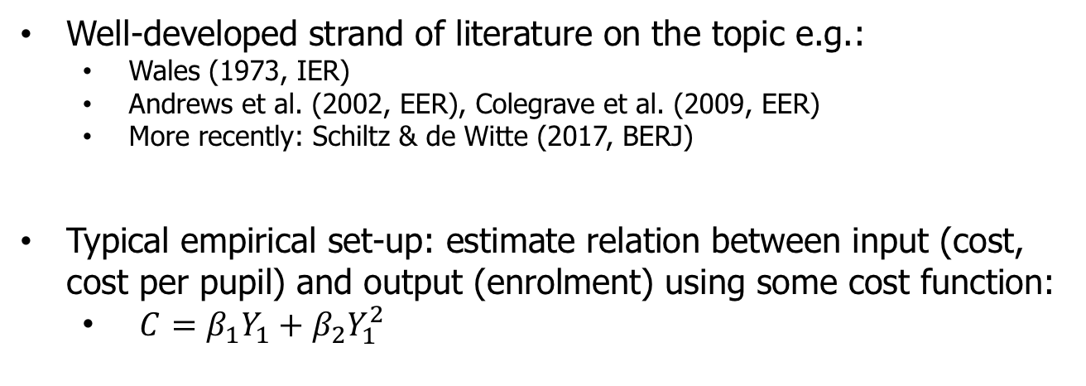
  Introduction
This paper is on economies of scale in Dutch primary education
  Cost perspective: are large educational institutions cheaper? Up to what point?
  Potential mechanisms: managerial oversight, capacity utilization
Well-developed strand of literature on the topic e.g.:
  Wales (1973, IER)
  Andrews et al. (2002, EER), Colegrave et al. (2009, EER)
  More recently: Schiltz & de Witte (2017, BERJ)
Typical empirical set-up: estimate relation between input (cost, cost per pupil) and output (enrolment) using some cost function:
  $C=β_{1}Y_{1}+β_{2}Y_{1}^{2}$

Slide 3
  Educational autonomy in the Netherlands
Key issue this paper: distinction between board and school size
  Board is often unit of analysis (or district) → data restrictions
School boards govern groups of school. Tasks are related to management:
  HRM;
  Finance, allocation of funding among schools;
  Accountability;
  Roughly equivalent to US school districts.
Schools:
  Curriculum;
  Teaching methods;
  In general: content.

Slide 4
  Motivation
Average school board has increased threefold since 1990
2011: legislation passed (“Merger test”)
  Legislation was softened after being criticized for not being substantiated by enough evidence
This paper’s aim: contribute to the knowledge on the relation between school size, board size and cost
Can we substantiate a maximum school size?
Can we substantiate a maximum board size?
More generally: at what level are scale economies relevant and what does this imply policy?

Slide 5
  Motivation
There are big boards with many small schools
There are small boards with few large schools
In other words:
  There is considerable variation in school size..
  Board and school size do not correlate (0.13)..
  Both may matter for average cost

Slide 6
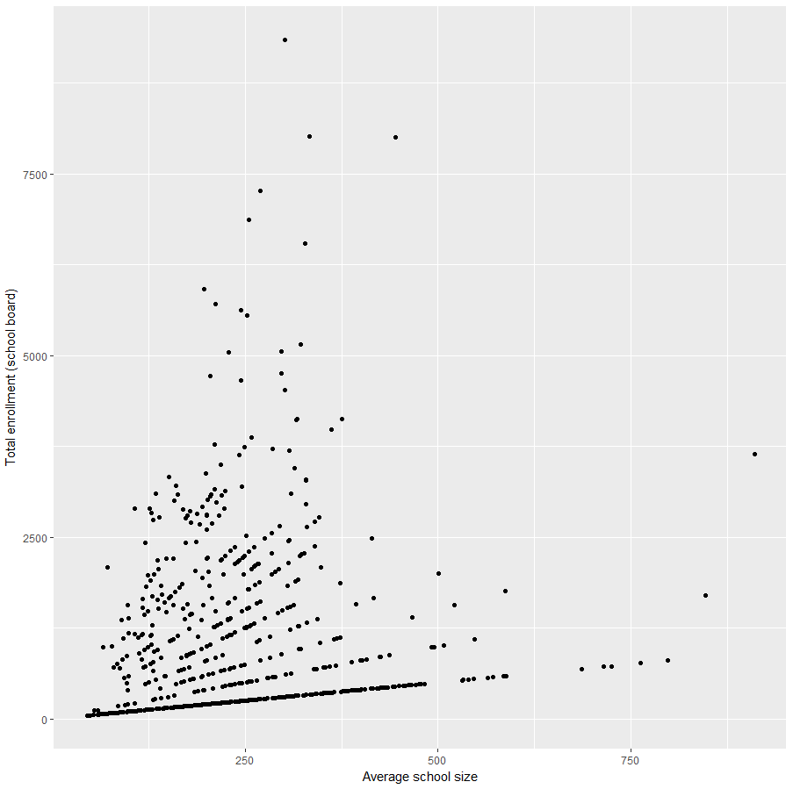
The largest board governs on average mid-sized schools
Total enrollment (board)
The largest schools are governed by a mid-sized board
Average school size

Slide 7
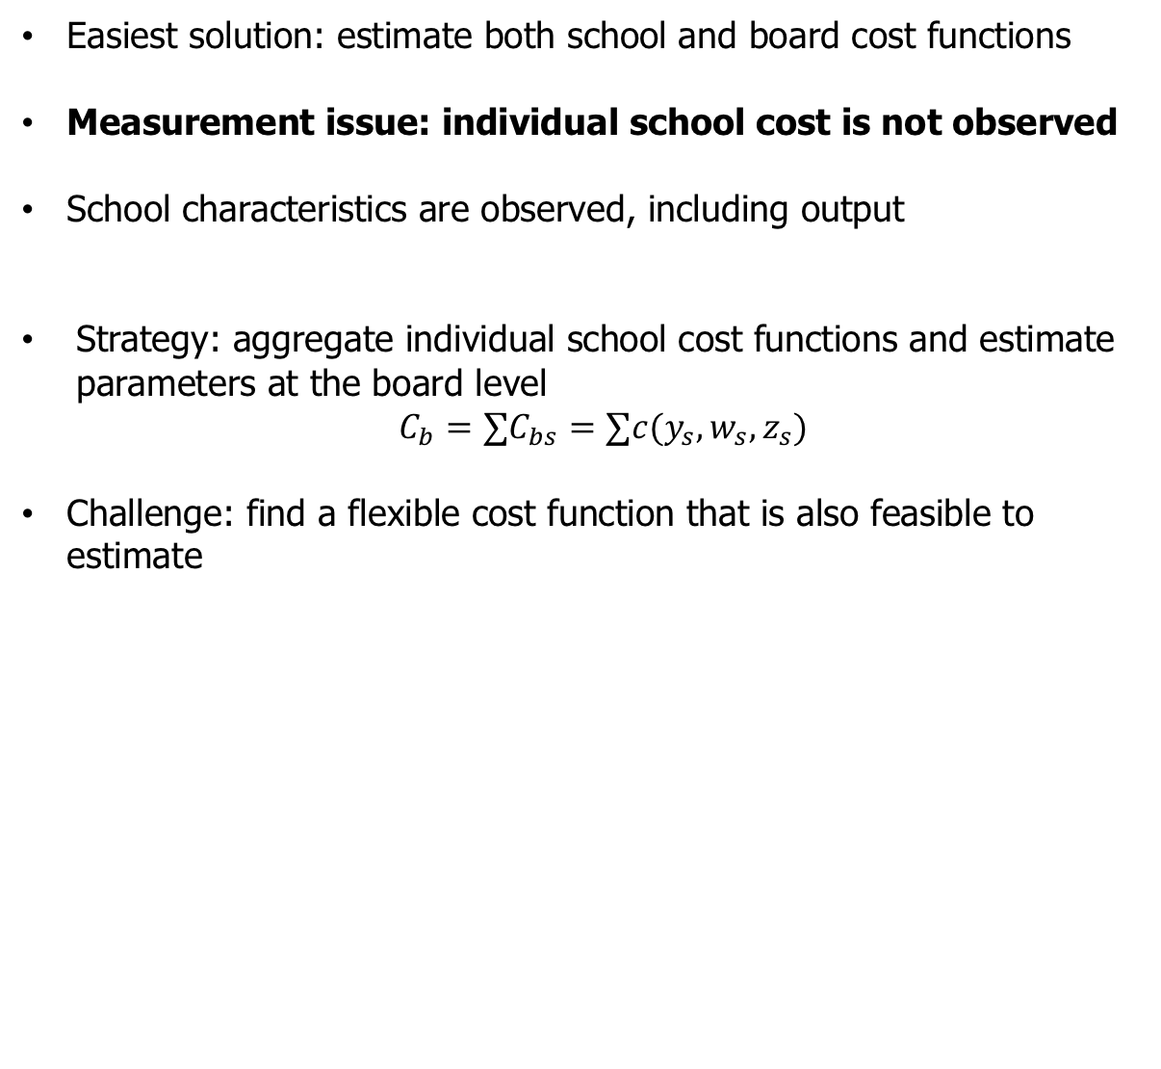
  Outline
Easiest solution: estimate both school and board cost functions
Measurement issue: individual school cost is not observed
School characteristics are observed, including output
Strategy: aggregate individual school cost functions and estimate parameters at the board level
$${C_{b}=∑C_{bs}=∑c(y_{s},w_{s},z_{s})}$$
Challenge: find a flexible cost function that is also feasible to estimate

Slide 8
  Data
Observed at board level
Input (cost) data
Factor prices: wages, material price index (only time variant)
Observed at school level
Output: enrolment corrected for pupil characteristics (three pupil categories)
Environment (municipality level): socio-economic control variables
2008-2015, 3.481 observations
Limited within variation -> identification relies on cross-sectional variation -> effectively there are ~700 observations
No causal inference → i.e. merger effects are neglected

Slide 9
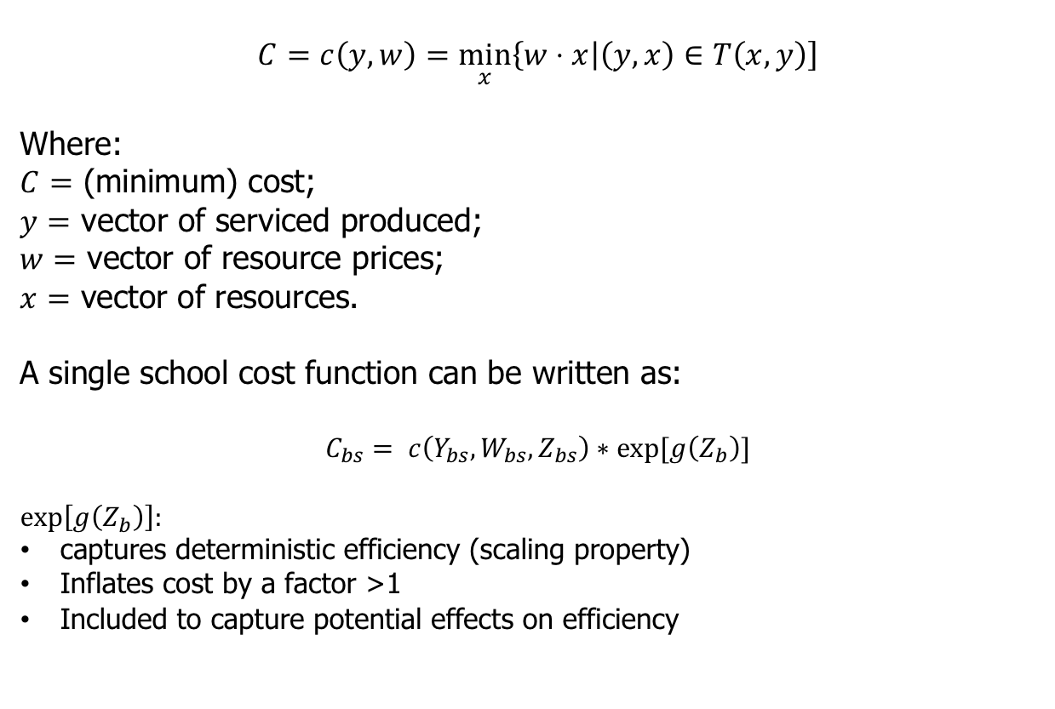
  Cost function
$$C=c\left(y,w\right)=\min_{x}\left\{w⋅x | \left(y,x\right)∈T\left(x,y\right)\right]$$
Where:
$C=$ (minimum) cost;
$y=$ vector of serviced produced;
$w=$ vector of resource prices;
$x=$ vector of resources.
A single school cost function can be written as:
$C_{bs}= c\left(Y_{bs},W_{bs},Z_{bs}\right)∗exp[g\left(Z_{b}\right)]$
$$exp\left[g\left(Z_{b}\right)\right]:$$
captures deterministic efficiency (scaling property)
Inflates cost by a factor >1
Included to capture potential effects on efficiency

Slide 10
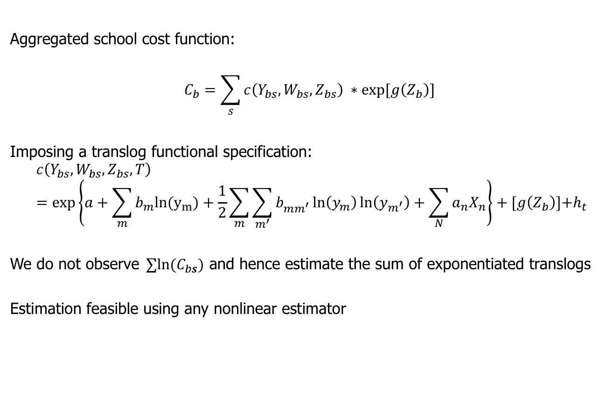
  School cost function
Aggregated school cost function:
$$C_{b}=\sum_{s}{c\left(Y_{bs},W_{bs},Z_{bs}\right)} ∗exp[g\left(Z_{b}\right)]$$
Imposing a translog functional specification:
$$c\left(Y_{bs},W_{bs},Z_{bs},T\right)=\exp\left\{a+\sum_{m}{b_{m}{ln(y}_{m})+\frac{1}{2}\sum_{m}{\sum_{m^{′}}{b_{mm^{′}}^{ }\ln\left(y_{m}\right)ln\left(y_{m^{′}}\right)+\sum_{N}{a_{n}X_{n}}}}}\right\}+[g\left(Z_{b}\right)]\text{+}h_{t}$$
We do not observe${ ∑ln(C}_{bs})$ and hence estimate the sum of exponentiated translogs
Estimation feasible using any nonlinear estimator

Slide 11
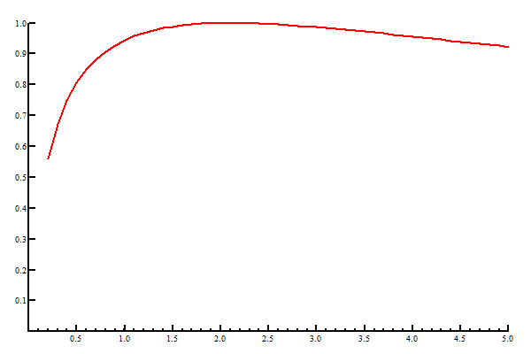
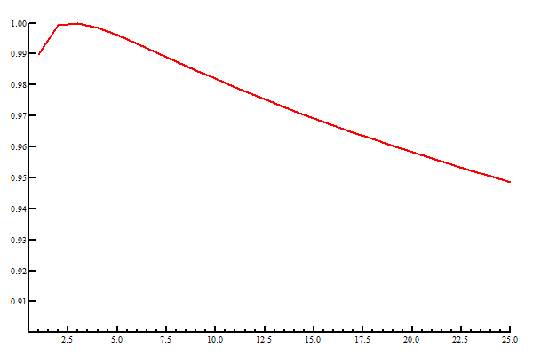
Results
Estimated relation between school size and cost
Estimated relation between efficiency (y-axis) and number of schools governed (x-axis)

Slide 12
Results
Model of fit tests indicate a significantly better fit than ”naive” models that do not incorporate school composition
Small schools are expensive on average (increasing economies of scale)
  Optimal scale estimated around 500 pupils
Large schools are not significantly scale inefficient
Scale effects at the board level are small to non-existent
Board with many schools are estimated slightly more inefficient

Slide 13
  Concluding remarks
School size matters more than board size
Small schools are especially expensive
Large schools and boards are not estimated significantly scale inefficient
Policy
  Scale inefficiency alone insufficient argument
  But: scale efficiency poses no valid argument for increasing scale much over 500 (schools) or in general for boards
  Other considerations: quality and scale, market power/freedom of choice, private costs

