Slide 1

Profit ratio (Return to the outlay) function
An application to the drinking water sector
June 14, 2017
EWEPA, London
Prof. Jos LT Blank
Dr. Alex AS van Heezik
www.ipsestudies.nl

Slide 2
  Outline
Optimizing some value function
An alternative: the return to the outlay function (profit ratio)
  Literature
  Specification
  Input demand and output supply functions
  Estimating
Application
  Drinking water sector in the Netherlands
  Data
  Model specification
  Results
  How to proceed
Notes:
We hebben een maand geleden ook een onderzoek afgerond. Dat onderzoek gaat over schoolgebouwen.
Of om preciezer te zijn: over de kosten van schoolgebouwen.
Even kort wat over het stelsel. Dat werkt als volgt. Schoolgebouwen zijn een gezamenlijke verantwoordelijkheid van gemeenten en schoolbesturen.
Dat is zo sinds 1997: toen zijn verantwoordelijkheden gedecentraliseerd van het Rijk naar gemeenten, en een aantal verantwoordelijkheden die gemeenten al hadden naar schoolbesturen.
Gemeenten doen de nieuwbouw, uitbreiding, grootschalige renovaties, echt de langdurige investeringsposten.
Zodra we het schoolgebouw ingaan, is het schoolbestuur aan zet. Zij betalen de energierekening en verzorgen het onderhoud.
Even om een indruk van de orde van grotote

Slide 3
  Duality diamond (Färe & Primont 1995)

Slide 4
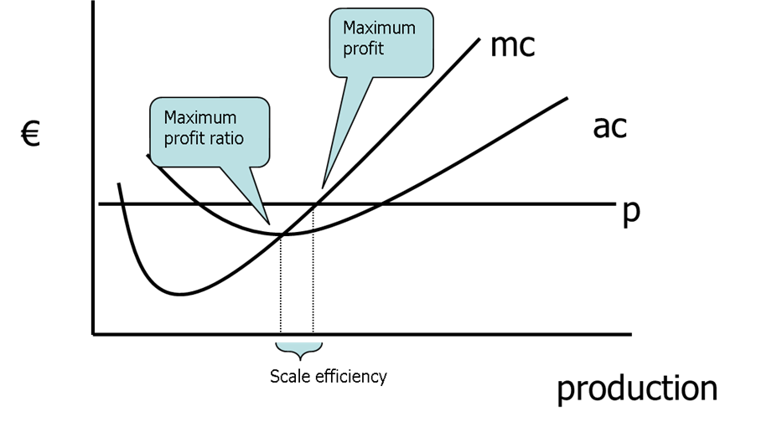

  The profit function
$$π=R−C=π(p,w)$$
Theoretically:
  It is not the ultimate productivity measure
  In a non-competitive market ➔ scale inefficiencies
Empirically:
  Negative or zero profits are hard to deal with, in particular regarding the first order conditions (Hotelling’s Lemma)

Slide 5
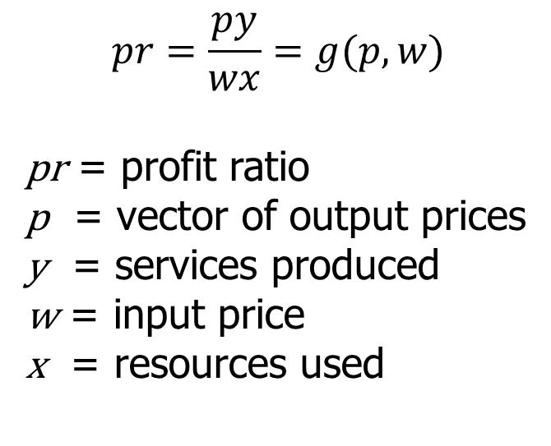
  The profit ratio function (return to the outlay function)
Balk, B. (2010). An assumption-free framework for measuring procuctivity change. Income and Wealth, 56(1), 33.
Färe, R., Grosskopf, S., & Zaim, O. (2002). Hyperbolic efficiency and return to the dollar. European Journal of Operational Research, 136(3), 671–679.
Georgescu-Roegen, N. (1951). The aggregate linear production function and its applications to von Neumann’s economic model. Activity Analysis of Production and Allocation, (13).
Kumbhakar, S. C. (2011). Estimation of production technology when the objective is to maximize return to the outlay. European Journal of Operation Research, 208, 170–176.
$$pr=\frac{py}{wx}=g(p,w)$$
pr = profit ratio
p = vector of output prices
y = services produced
w = input price
x = resources used

Slide 6
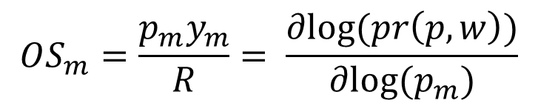
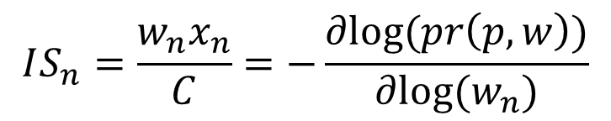
  1st and 2nd order conditions
Homogeneous degree 1 in output prices;
Homogeneous degree -1 in input prices;
Non-decreasing and convex in output prices;
Non-increasing and convex in input prices;
$$OS_{m}=\frac{p_{m}y_{m}}{R}= \frac{∂log⁡(pr\left(p,w\right))}{∂log⁡(p_{m})}$$
$$IS_{n}=\frac{w_{n}x_{n}}{C}=−\frac{∂log⁡(pr\left(p,w\right))}{∂log⁡(w_{n})}$$

Slide 7
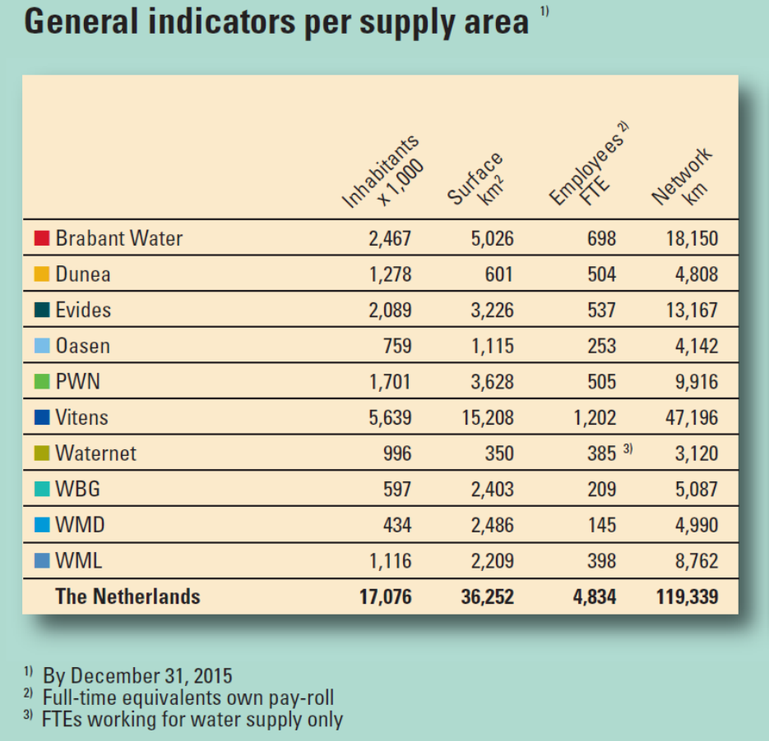
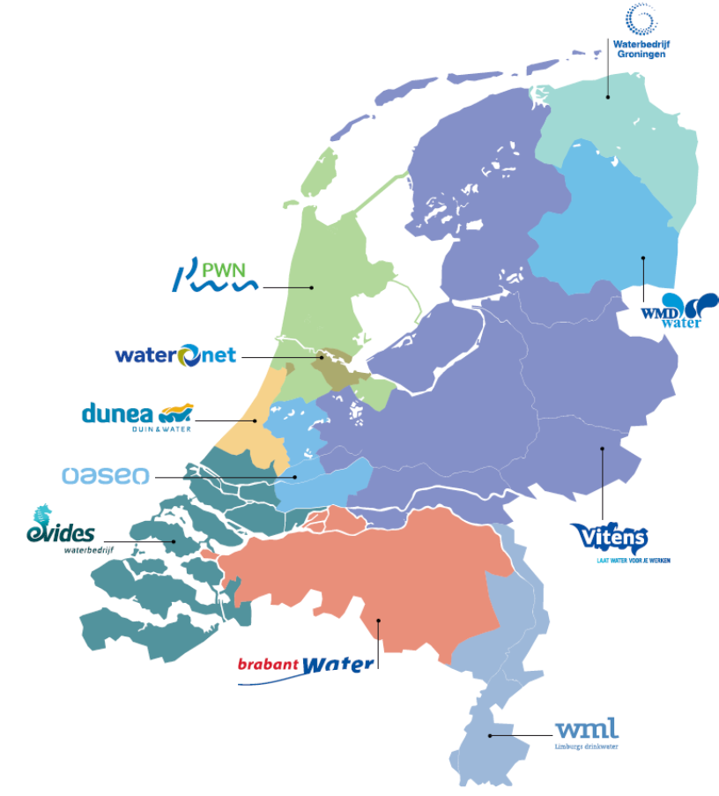
  Drinking water sector (I)

Slide 8
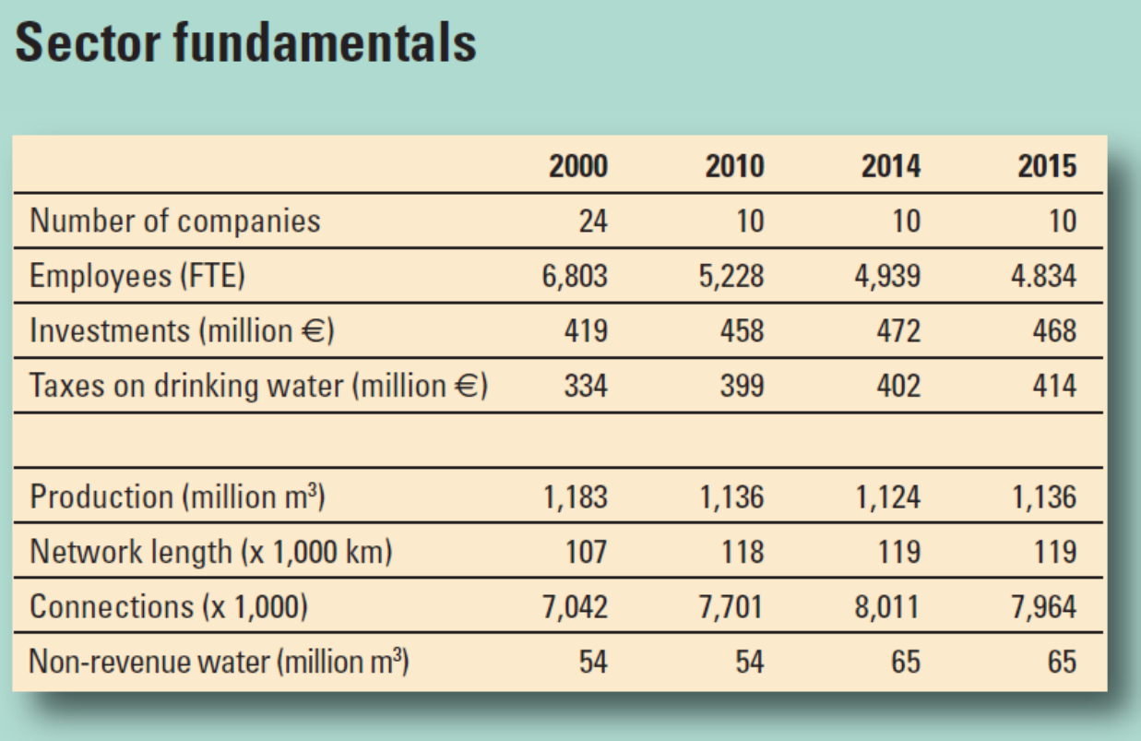
  Drinking water sector (II)

Slide 9
  Drinking water sector (III)
Funding
The costs of drinking water companies are fully covered by the proceeds from the sale of drinking water;
The drinking water tariff consists of a fixed amount per connection per year (fixed rate) and a variable rate for consumption per cubic meter.
Regulatory environment
Main legislative framework: Drinking Water Act (2011)
ownership restricted to local/regional authorities (the drinking water companies are public limited companies);
companies governed by local/regional shareholders (municipalities and provinces);
supervision by national government with main focus on water quality, continuity (public health) and efficiency;
There is a mandatory benchmarking every three years.

Slide 10
  Specification
Input prices:
  Labor (=w1);
  Material supplies (=w2);
  Capital (=w3).
Output prices:
  Connections (=p1);
  Water consumption (m³) (=p2).
Technical change:
Time trend
Functional form:
translog
Data:
10 companies
2003, 2006, 2009, 2012, 2015
Environmentals:
  Surface (km²) (=z1)

Slide 11
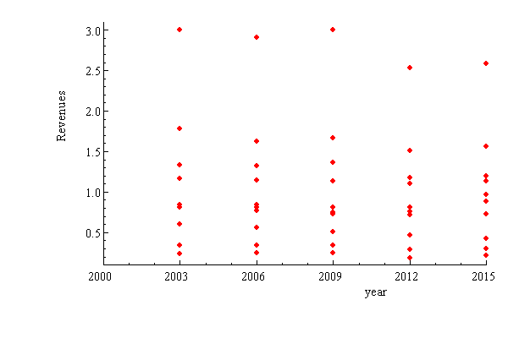
  Revenues per year

Slide 12
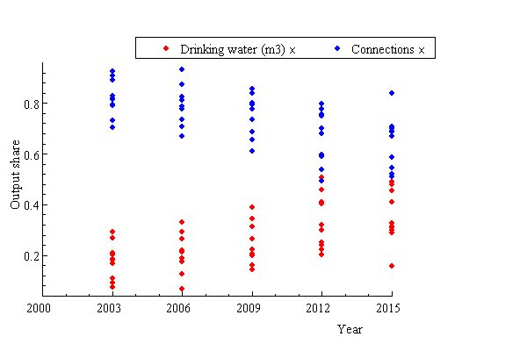
  Revenue share per year

Slide 13
  Estimates (COLS, SFA)
  Labor (=w1);
  Material supplies (=w2);
  Capital (=w3).
  Connections (=p1);
  Water consumption (m³) (=p2).
  Population density (=z1)
Note: homogeneity reqs. implemented by choosing numeraire (p2 and w3)
 |  |  | Standard
Variable | Parameter | Estimate | Error | t-statistic | Inflation | Corrected t-stat
constant | A0 | 1,761 | 0,038 | 46,617
p1 | B1 | 0,350 | 0,011 | 32,443 | 2,27275 | 14,275
p1*p1 | B11 | 0,170 | 0,006 | 28,903 | 1,94061 | 14,894
w1 | C1 | -0,333 | 0,047 | -7,034 | 3,09396 | -2,273
w2 | C2 | -0,360 | 0,052 | -6,895 | 3,12043 | -2,210
w1 x w1 | C11 | -0,013 | 0,775 | -0,017 | 2,6782 | -0,006
w1 x w2 | C12 | -0,115 | 0,776 | -0,148 | 2,69603 | -0,055
w2 x w2 | C22 | 0,058 | 0,777 | 0,075 | 2,71155 | 0,028
z1 | D1 | 0,060 | 0,025 | 2,374 | 3,33951 | 0,711
z1 x z1 | D11 | -0,057 | 0,037 | -1,550 | 3,32596 | -0,466
p1 x w1 | E11 | 0,001 | 0,011 | 0,118 | 2,78488 | 0,042
p1 x w2 | E12 | 0,008 | 0,013 | 0,596 | 2,81588 | 0,212
z1 x w1 | F11 | -0,081 | 0,011 | -7,293 | 3,14094 | -2,322
z1 x w2 | F12 | -0,016 | 0,018 | -0,892 | 3,15892 | -0,282
z1 x p1 | G11 | 0,008 | 0,006 | 1,301 | 2,86592 | 0,454
trend | H1 | 0,001 | 0,004 | 0,269
trend x p1 | I11 | 0,002 | 0,001 | 2,179 | 2,29464 | 0,949
trend x w1 | J11 | 0,001 | 0,004 | 0,249 | 2,71292 | 0,092
trend x w2 | J12 | 0,000 | 0,005 | 0,097 | 2,71157 | 0,036
SFA no convergence

Slide 14
  Results (COLS, SFA)
Requirements
R² PR function | 0,93
R² ISH1 | 0,60
R² ISH2 | 0,20
R² OSH1 | 0,94
non-decreasing in p | ü
convex in p* | ü
non-increasing in w | ü
convex in w* | ü
Other outcomes
technical change | û
output biased technical change | ü
input biased technical change | û
input-output substitution | û

Slide 15
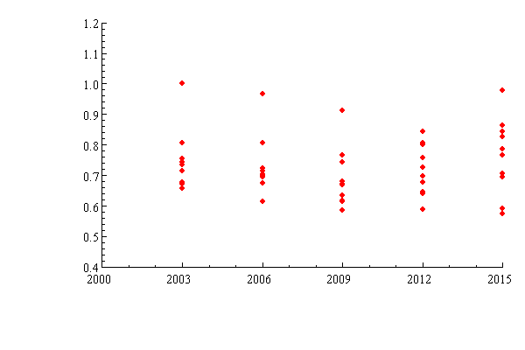
  Results (efficiency per year)

Slide 16
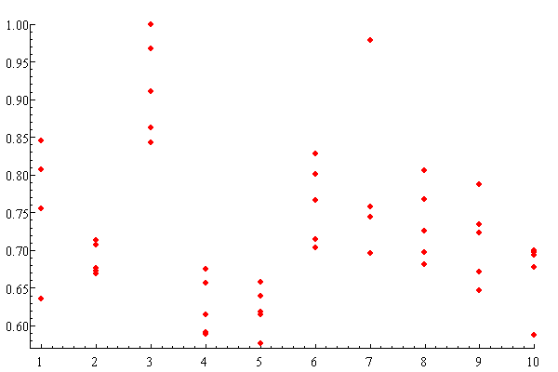
  Results (efficiency score per company)
Company

Slide 17
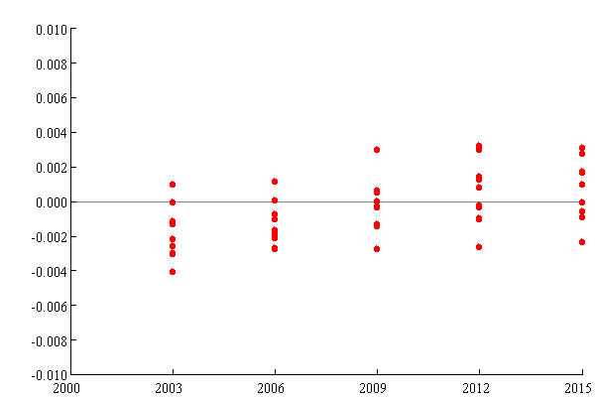
  Results (technical change)

Slide 18
  Results (population density and PR)

Slide 19
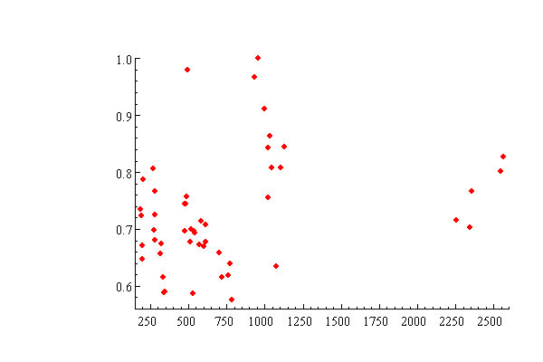
  Results (scale economies)
Efficiency
Connections

Slide 20
  Concluding remarks
Profit ratio interesting approach;
Empirically easier to handle than profit function;
Application to drinking water plausibel results;
Work in progress:
Other estimation methods;
More applications;
Deriving other (constrained) models ➔ decomposition.

