Slide 1

Public Sector Productivity
A brief overview of research activities in the Netherlands
25-4-2017
OECD Presentation
Drs Frans van Dongen
Prof. Jos Blank
Dr. Alex van Heezik
Thomas Niaounakis MSc

Slide 2
  Institute for Public Sector Efficiency Studies (2007-…)
Academics:
  Researchers affiliated with Delft University of Technology and Erasmus University of Rotterdam
  Chair at Erasmus Rotterdam University
  PhD students
  Publications in top-ranked journals
  Broad international network
Policy advisory and involvement:
  Large network in Public administration and Public Services
  Policy research
  Direct consultancy for policy makers and politicians
  Articles in professional journals
Teaching:
  Bachelor and Master courses
  Masterclasses for Public Management and policy makers

Slide 3

  Academics
Quantitative empirical research
State-of-the-art methods
  Cost function modelling
  Frontier analyses (SFA, DEA, Kernel Est.)
Data collection
  Numerous cross section data sets at firm level (hospitals, schools et cetera)
  Data set Public Sector (DPS): meso level data 1980-2015
  Containing: costs, personnel, performance, environment, governance

Slide 4
  Empirical model (general approach)
Political preferences
Services
Resource prices
Management
Efficiency
Costs
Governance
Technology
Environment

Slide 5
  FOME and BITS model
FOME model
BITS model
Sector
Organization
Funding
Ownership
Market
structure
Environment
Business conduct
Internal governance
Technology
Strategy
Parameters
Lumpsum
Performance
Sanctions
Service
Agency
Quango
Private
Profit
Demarcation
Competition
Scale
Prices
Surveillance
Chains
Contributions
Consumer-subsidies
Purchase obligation
Insurance
HRM
Outsourcing
ICT
Allocation
Governance
Management
structure
Decentralization accountability
Supervisory Board
R&D
Diffusion of innovations
Mergers
Acquisitions
Cooperation

Slide 6
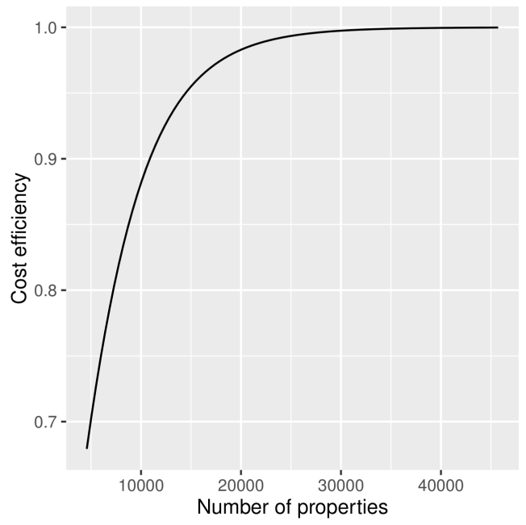
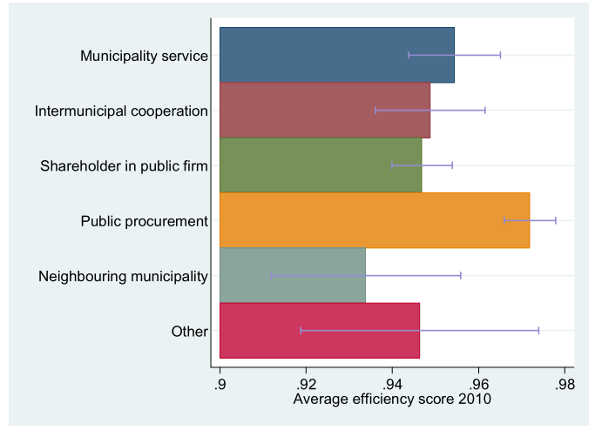
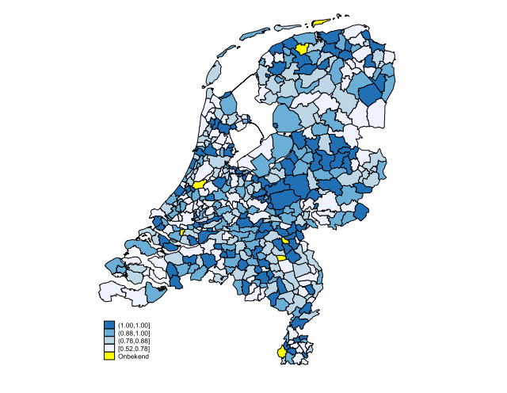
  Example 1: Local government efficiency
Registry offices: efficiency scores
Waste collection: organizational form
Tax collection: scale and inter-municipal cooperation

Slide 7
  Example 2: Productivity and policy trends
Policy interventions

Slide 8
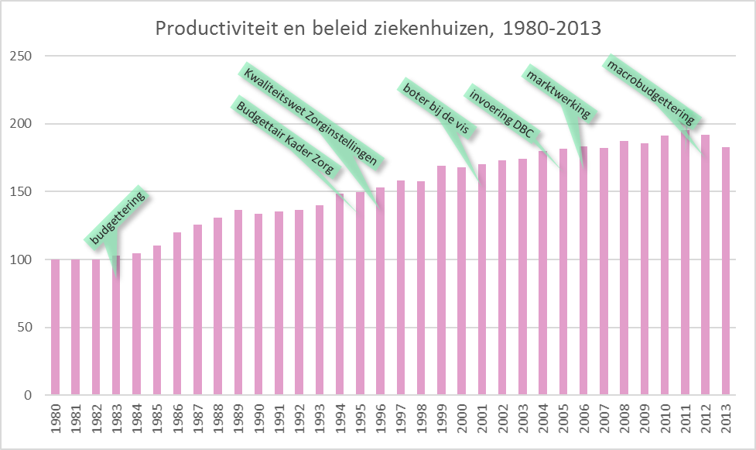
  Example 2: Productivity and policy trends
The relationship between policy and productivity

Slide 9
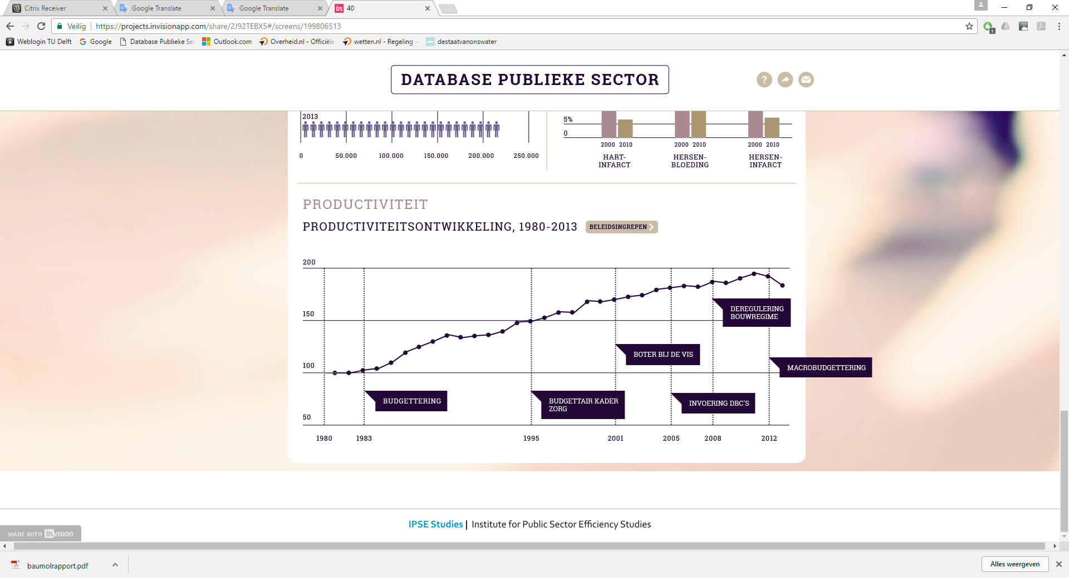
  Example 2: Productivity and policy trends
The relationship between policy and productivity

