Slide 1


Productivity and Efficiency Measurement: A State of the Art Approach
Presentatie ETI 4 april
Prof. dr. Jos LT Blank

Slide 2
Outline
Conceptual issues:
  What is efficiency?
  What is productivity?
Measurement methods:
  Frontier Analysis
  Stochastic Frontier Analysis (SFA)
  Data Envelopment Analysis (DEA)
  Recent developments: Stochastic DEA, Kernel Estimation (Local Estimation)
Local Estimation
Application (secondary education)

Slide 3
  What is technical efficiency (Koopmans)?
It is not possible to increase the output of a product without decreasing the production of at least one of the other products, or increasing the employment of at least one resource.
It is not possible to decrease the employment of a resource without increasing at least one of the other resources, or decreasing the output of at least one of the products.

Slide 4
Technical efficiency (Debreu-Farell)
the technical efficiency equals 1 minus the proportional decrease of all resources without decreasing the output.
the technical efficiency equals 1 minus the proportional increase of all outputs without increasing the inputs.
This is a so-called radial measure
➔Koopmans eff <= Debreu Farell eff

Slide 5
Optimal allocation of resources: allocative inefficiencies
50000
40000
Isoquant (50000)
Line 1
Capital
30000
20000
Line 2
10000
0
5
10
15
20
25
30
35
40
45
50
Employees

Slide 6
  What is productivity?
Ratio between outputs and resources
Productivity is a broader concept than efficiency, since it also includes “inefficiencies” due to scale economies and technical change.
Technical and allocative efficiency represent distant to frontier or best practice
Scale economies and technical change are characteristics of the frontier (wrt different scale and time)

Slide 7
Note !!!
This presentation is about a classical setup with inputs, outputs et cetera.
Models and estimation techniques are also very suited for:
Analysing environmental issues:
  Nitrogen reduction in agriculture;
  CO2 emissions;
  Trade off between types of energy;
Risk management and safety analysis.

Slide 8
Set up empirical research
Model choice and specification;
  E.g. Cost function;
  E.g. translog specification.
Definition variables and data collection;
  Output quantities and prices;
  Input quantities and prices;
  Environmental variables;
  Managerial or policy variables.
Estimation procedure and diagnostic testing;
  DEA;
  SFA;
  Local estimation.
Derivation economic results and interpretation.
FOCUS

Slide 9
Frontier Analysis: SFA en DEA
Output
Resources

Slide 10

Stochastic Frontier Analysis
25000
22500
$$≈N(μ,σ^{2})$$
20000
Residue
17500
15000
Square metres of green area
12500
10000
7500
5000
2500
0
10
20
30
40
50
60
70
80
90
100
Employees

Slide 11
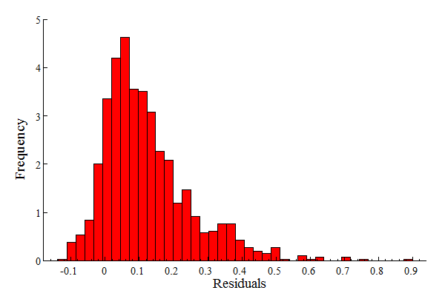
Distribution of the residuals

Slide 12
Distribution of measurement and specification errors

Slide 13
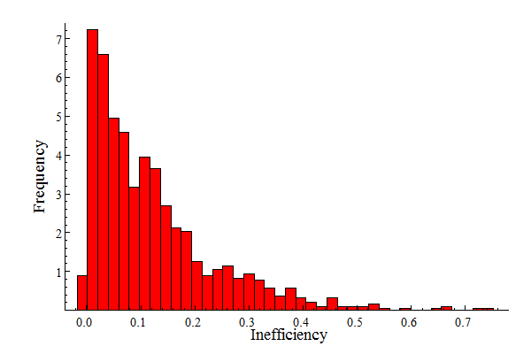
Distribution of the efficiency component

Slide 14
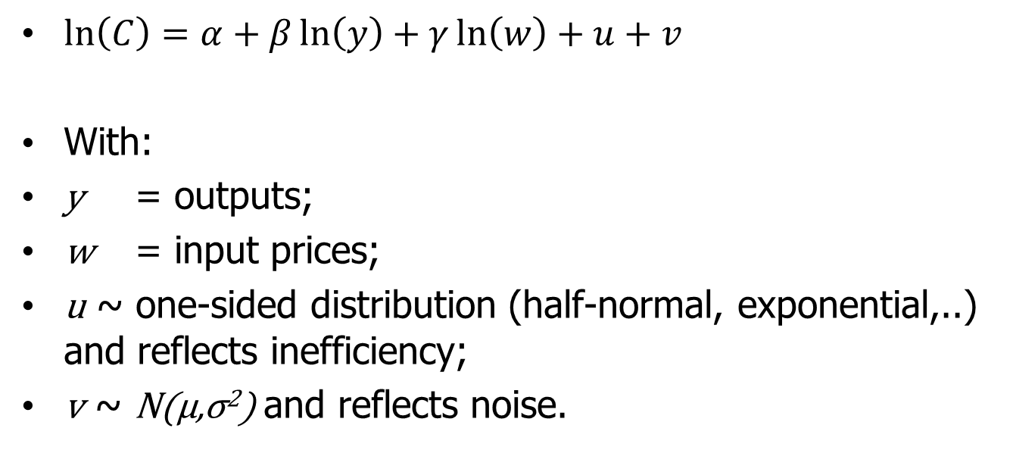
SFA in mathematical terms
ε=u+v is a composed error ➔ ML
$\ln\left(C\right)=α+β\ln\left(y\right)+γ\ln\left(w\right)+u+v$
With:
y = outputs;
w = input prices;
u ~ one-sided distribution (half-normal, exponential,..) and reflects inefficiency;
v ~ N(μ,σ²) and reflects noise.

Slide 15
Stochastic Frontier Analysis
Criticism on:
Functional form (one size fits all);
Distributional assumptions on efficiency term;
Computational problems (convergence).
Advantages:
Stochastic aspects ( we do not know reality);
Easy implementation of environmental aspects;
Easy derivation of economies of scale, economies of scope, efficiency scores, technical change.

Slide 16
Data Envelopment Analysis (DEA)

Slide 17
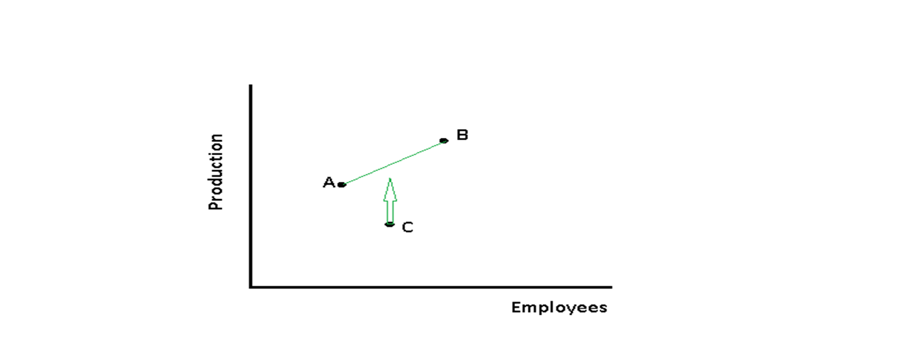
Principles of DEA
Expand output as much as possible, but only as long as ..
You can find a point that is a linear combination of two other observations:

Slide 18
Data Envelopment Anaysis (DEA)
Criticism on:
No stochastic component;
Sensitive to outliers;
Difficult to control for environmental variables;
Efficiency by default;
Economies of scale, economies of scope, technical change not straightforward.
Advantage:
Intuitive appealing method;
Local method (comparison with obs^{s} in neighborhood)

Slide 19
Non Linear Local Estimation (in multiple stages)
Combines best of both worlds:
Local technique;
No a priori functional form (just 1st order Taylor approx.);
Regression analysis;
Stochastic component;
Easy to control for environmental variables;
Easy to derive scale effects, technical change etc.

Slide 20
How does it work?
Observation by observation technique (cf DEA);
Based on weighted least squares;
Observations in “Neighbourhood” get a large weight;
Distance to reference point determines the weight of an observation.
To identify frontier apply 2nd and further stages:
Use residual from 1st (or former) stage as a proxy for efficiency;
Re-estimate the model by also including efficiency in the weight function;

Slide 21
Egg of Columbus?
Unfortunately not:
a priori weighting scheme (exponential, normal etc.);
Assumptions to derive efficiency scores (COLS, MOLS,…) or (as I did) an iterative procedure

Slide 22
Application: secondary education

Slide 23
Data and variables
About 250 school boards
2007-2010
Three outputs:
  Number of pupils grades 1-2, corrected for pass rates;
  Number of pupils in vocational training, grades 3-4, corrected for pass rates;
  Number of pupils in general education, grades 3-6, corrected for pass rates.
Five inputs:
  Management;
  Administrative personnel;
  Teaching personnel;
  Energy;
  Material supplies.
Technology:
  Trend variable

Slide 24
Model and parameter estimates
Model:
Cost function model;
Cobb-Douglas function (1st order Taylor approx.).
Estimates:
Converge in three steps;
Plausible and reliable estimates;
Plausible economic results (see next slides).

Slide 25
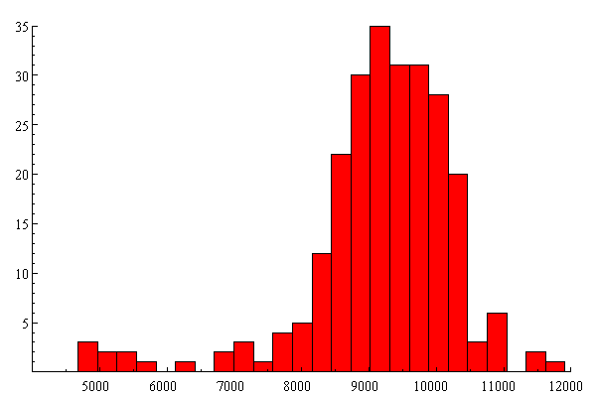
Marginal costs grade 1-2

Slide 26
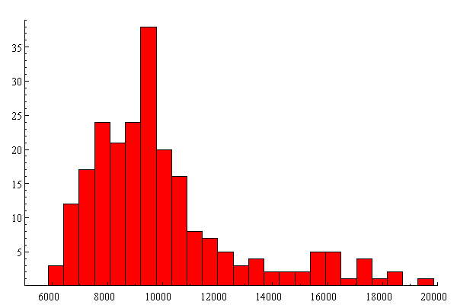
Marginal costs vocational 3-4

Slide 27
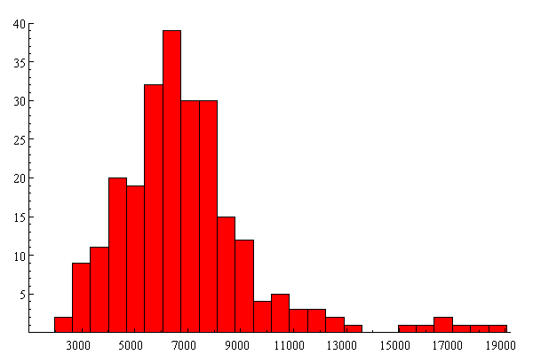
Marginal costs general grades 3-6

Slide 28
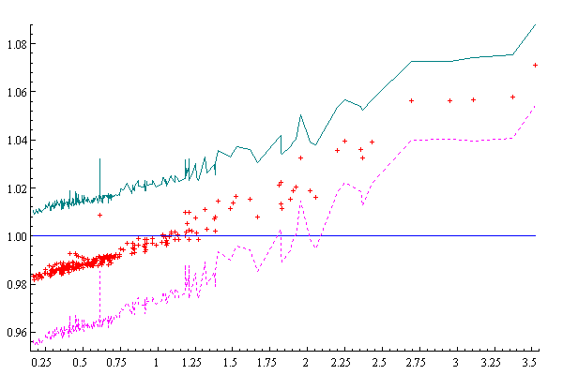
Results: economies of scale by cost flexibility

Slide 29
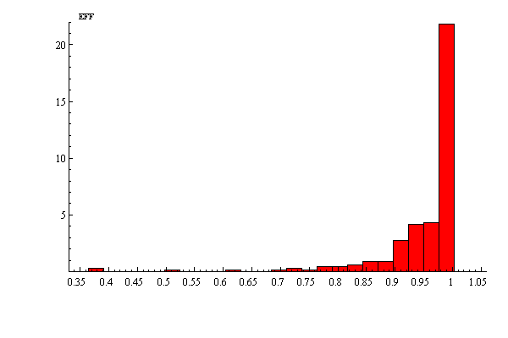
Cost efficiencies

Slide 30
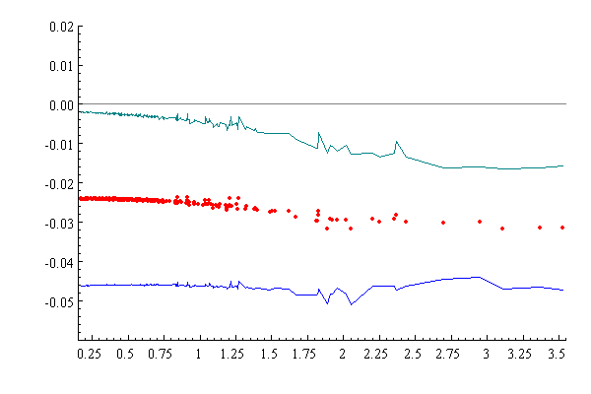
Results: technical change

Slide 31
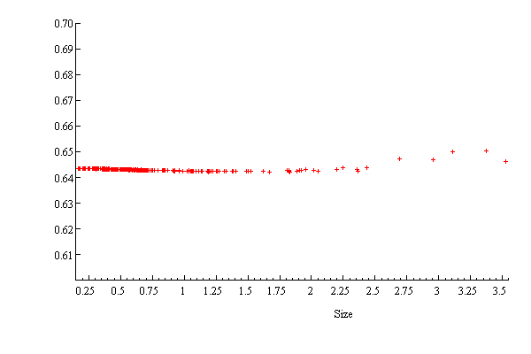
Results: optimal allocation of teaching personnel and scale

Slide 32
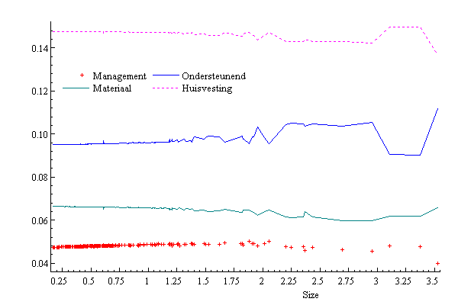
Results: optimal input allocation and scale 4 other inputs

Slide 33
Some conclusions and considerations
Iterative NLLS is an interesting alternative for SFA;
It avoids questionable assumptions on functional form and on stochastic distributions (as well as computational problems);
However, in return we need assumptions on weighting schemes;
It produces plausible results, based on “local technologies” .

Slide 34
Further research
Does this approach provide more robust results wrt assumptions on the weighting scheme compared to SFA?
Does this approach provide more efficient estimates of scale economies, technical change etc. compared to SFA?

